Slide 1

Analysis of Algorithms 1
(Fall 2013)
Istanbul Technical University
Computer Eng. Dept.
Chapter 9
Medians and Order Statistics
Last updated: November 11, 2009

Slide 2
Order Statistics
The ith order statistic of a set of n elements is the ith smallest element.
Minimum: first order statistic (i = 1),
Maximum: nth order statistic (i = n).
Median,: "halfway point" of the set.
  Odd n: median occurs at i = (n + 1)/2
  Even n:
    lower median at floor((n + 1)/2)
    Upper median at ceil((n + 1)/2)

Slide 3
Selection Problem
Input: A set A of n (distinct) numbers and a number i, with 1 ≤ i ≤ n.
Output: The element x ϵ A that is larger than exactly i - 1 other elements of A.
can be solved in O(n lg n) time, since we can sort the numbers using heapsort or merge sort and then simply index the ith element in the output array
But there are faster methods.

Slide 4
Minimum and Maximum
The best algorithm has complexity of θ(n)
Easiest algorithm:
MINIMUM(A)
1 min ← A[1]
2 for i ← 2 to length[A]
3 do if min > A[i]
4 then min ← A[i]
5 return min

Slide 5
Randomized Select
RANDOMIZED-SELECT(A, p, r, i)
1 if p = r
2 then return A[p]
3 q ← RANDOMIZED-PARTITION(A, p, r)
4 k ← q - p + 1
5 if i = k ▹ the pivot value is the answer
6 then return A[q]
7 elseif i < k
8 then return RANDOMIZED-SELECT(A, p, q - 1, i)
9 else return RANDOMIZED-SELECT(A, q + 1, r, i - k)
expected time of RANDOMIZED-SELECT is Θ(n).

Slide 6
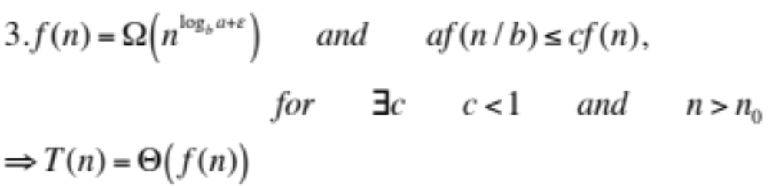
Randomized Select
RANDOMIZED-SELECT(A, p, r, i)
1 if p = r
2 then return A[p]
3 q ← RANDOMIZED-PARTITION(A, p, r)
4 k ← q - p + 1
5 if i = k ▹ the pivot value is the answer
6 then return A[q]
7 elseif i < k
8 then return RANDOMIZED-SELECT(A, p, q - 1, i)
9 else return RANDOMIZED-SELECT(A, q + 1, r, i - k)
T(n)=T(n/b)+ Θ(n)
T(n)=Θ(n) //Master Thm, Case 3
Θ(n)

